Slide 1

Iordache Ionut, Dorina Aliu, Cristian Muresan, Cristian Ciula, Janos Dezsi
Soft Skills
Needed in Testing

Slide 2
Content
Portrait of a good Tester
What are Soft skills?
Importance of Soft Skill
Important Soft Skills?
Communication skills
Proactive/Results Driven
Problem Solving
Self Motivation
Adaptability
Team-Working Skills
Creativity and Problem Solving Skills
Time Management and Effort Prioritization
Critical Thinking and Decision Making
Conclusion

Slide 3
Portrait of a good Tester
Testing involves revealing the unknown

Slide 4
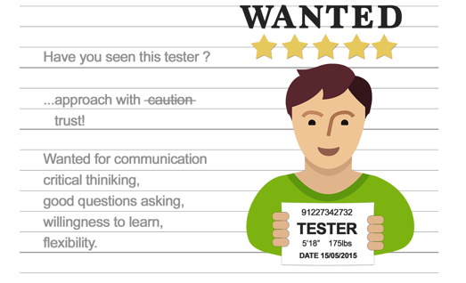
What is a tester
A person who knows that things can be different." Jerry Weinberg
A person who is able to discover highly relevant information in a fast way about a product
A person you can trust." Ilari Henrik Aegerter

Slide 5
Five of the most important soft skills of a tester
Communication
  is able to quickly discover highly relevant information
  testing is a matter of critical thinking and creativity
Critical thinking
  Testing means questioning the product in order to evaluate it.' James Bach
  Testing involves revealing the unknown
  analysis of a product or requirement by observation
"If you can't write your message in a sentence, then you won't be able to bring it in an hour." Dianna Booher

Slide 6
James Bach states: "There is a difference between having a question and asking a question."
Ask Good Questions
Good questions generate good answers
It is important to ask questions in order to obtain as much information as possible and to clarify any doubt so that we do not make assumptions when testing
it is very important to ask the right person, the right question, at the right time, with the right tone and in the right place

Slide 7
Bach said: "It takes the ability to love the confusion that comes with learning complicated things."
The desire to learn
The process of continuous learning is essential to become better at what we do
Flexibility
We need this ability to identify when it is necessary to shift our attention from detail to exploration.

Slide 8
What are Soft skills?
Soft skills is a synonym for "people skills." The term describes those personal attributes that indicate a high level of emotional intelligence.
Unlike hard skills, which describe a person's technical skill set and ability to perform specific tasks, soft skills are broadly applicable across job titles and industries.
It's often said that hard skills will get you an interview but you need soft skills to get -- and keep -- the job.

Slide 9
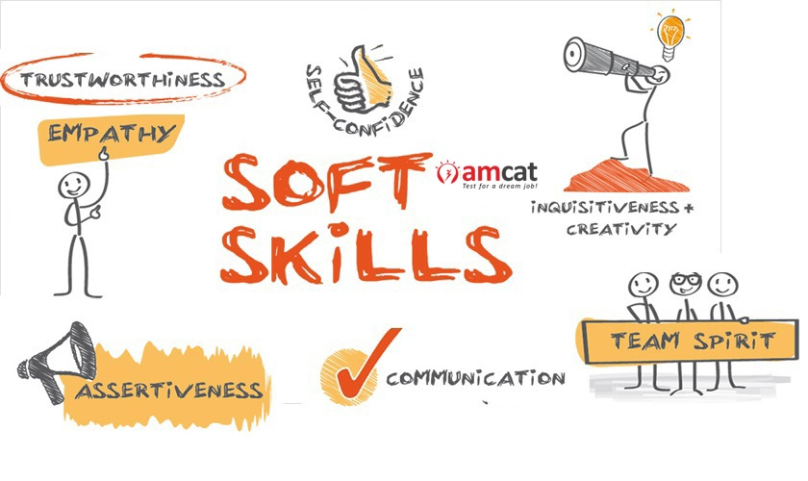
Importance of Soft Skill
To handle interpersonal relations
To take appropriate decisions
To communicate effectively
To have good impression and impact to gain professional development

Slide 10
What are the Most Important Soft Skills?
Communication skills
Proactive/Result Driven
Problem Solving
Self Motivation
Adaptability
Team-Working Skills
Creativity and Problem Solving Skills
Time Management and ability to work under Pressure

Slide 11

Communication skills
Communication skills are always top of the ‘essential skills’ list in any job advertisement.
People with strong communication skills can build relationships (from the initial building rapport through to a longer-term relationship), listen well, and vary their communication to suit the circumstances.

Slide 12

Proactive
Result Driven
Understand the scope of the project
Organize and prioritize the activities to meet the end objective
Well defined goals, taking action.

Slide 13

Self Motivation
People who are self-motivated get on by themselves.
They don’t need close supervision and they are good to work with because they are generally positive about life and can be counted upon to keep going.
It also helps to work on your personal resilience and adaptability to change.

Slide 14

Adaptability
The market and business change constantly. The project requirements can be also changed and the timeline is adjusted.
That’s why having soft skills or improving them helps you to adept quickly to any situation and become a strong team player.

Slide 15

Team-Work
Like leadership, good teamwork involves a combination of other soft skills.
Working in a team towards a common goal requires the intuition and interpersonal acumen to know when to be a leader, and when to be a listener.
Good team players are perceptive, as well as receptive to the needs and responsibilities of others.

Slide 16
Creativity and Problem-solving
Creativity and problem-solving skills are highly valued because they are hard to develop.
There are many people who believe that creative thinkers are born, not made, and there are certainly some people who find these skills much easier.
But, like other skills, you can develop them if you work to do so and our pages on these topics will give you some ideas about how to do this.

Slide 17
Time Management and Ability to work under pressure
Many would say that these two skills, which often go hand-in-hand, are more an attitude than a skill.
However they can also be developed and honed, which is why we include them as skills.
Highly valued by employers, they are also very useful for organizing a family or a team, and for making sure that the job gets done.

Slide 18
Time Management and Effort Prioritization
Testers need to juggle with a lot of tasks.
May be involved in more than one project at the same time. It is very important to organize and prioritize the time and projects.
If a tester wants to be proactive, work efficiently and get results, then is critical to be highly organized plan ahead and get priorities right

Slide 19
Critical thinking and Decision Making
It is crucial for Software Testing
Always looking for the root of the problem, know what question to ask.
Same have it as a gift, others can work on this ability.
Come with experience, and with a lot of work
Importance of making decision

Slide 20
Conclusion
More and more businesses are considering soft skills as important job as an criteria.
An increase in service industry emphasizes the need for soft skills.
Soft skills are used in personal and personal life.

Slide 21
Thanks
Keep Going☺

